Slide 1

Welcome,
Students!

Slide 2
English Lesson
UNIT 1
FADS AND FASHION
Lesson 2:
Reading - Crazes
with: Ms Quin

Slide 3
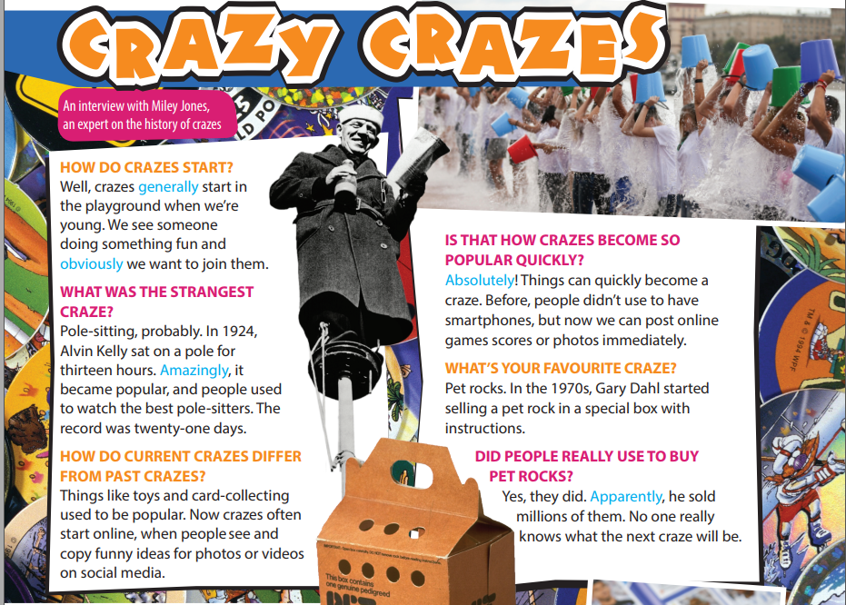

Exercise 1:
Read and interview with an expert of crazes
What is the purpose of the article?

Slide 4

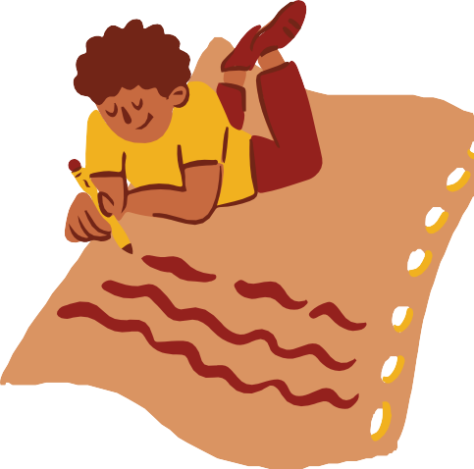
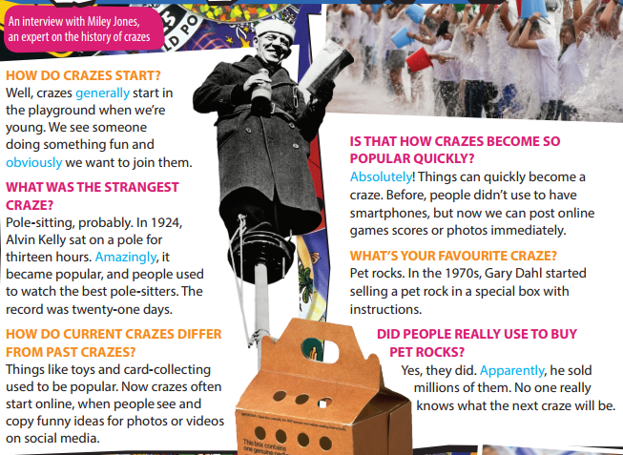
Exercise 2:
Read and listen to the interview again
Write the questions for the answers from 1 to 5.
Questions
When did the craze of pole-sitting start?
For how long did Alvin Kelly sit on a pole?
Where do crazes often start these days?
Where do crazes often start these days?
How many pet rocks did he sell?
Answers
in 1924.
For thirteen hours
On social media
He sold pet rocks
Millions

Slide 5

Exercise 3:
Vocabulary Plus
Use a dictionary to check the meaning of the words in blue in the text.
Words | Meanings
crazes (n) | activities, objects, or ideas that are extremely popular, usually in the short time
generally (adv) | usually or in most situations
obviously (adv) | in a way that is easy to understand or see
pole (n) | a long, thin stick of wood or metal, often used standing straight up in the ground to support things
amazingly (adv) | in a way that is extremely surprising
absolutely (adv) | completely
apparently (adv) | used to say that something seems to be true, although it is not certain

Slide 6
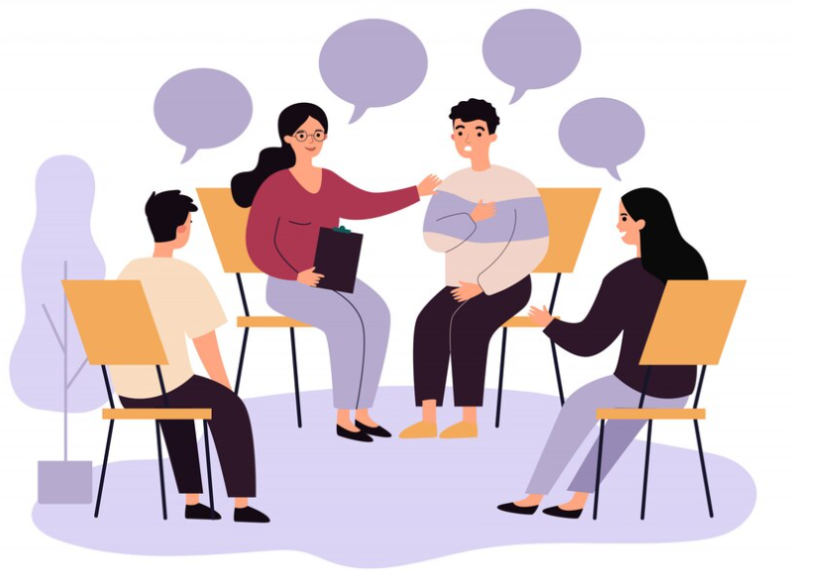
Exercise 4:
Use It! Work in groups. Say what you think of the crazes in the interview.
Take a vote on which is the silliest, the strangest and the most fun

Slide 7
Homework
 Learn by heart all the new words.
Do exercises in worbook
Prepare for new lesson

Slide 8

THANK YOU!

